Slide 1
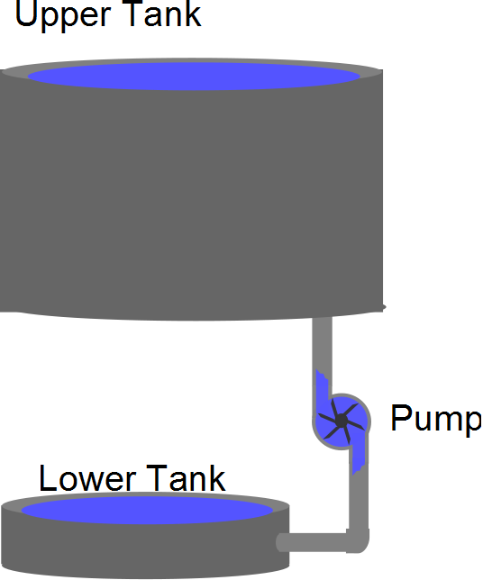

Slide 2


Slide 4
Charge built up on the capacitor plate
New charge repelled

Slide 5
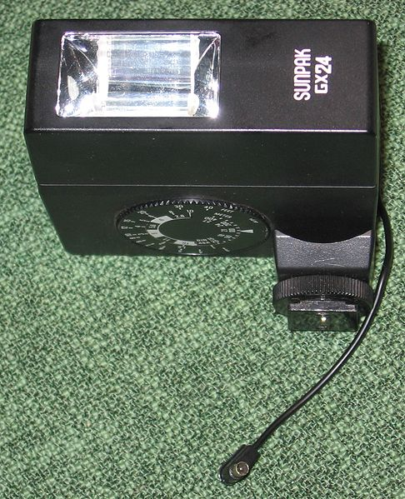

Slide 6

Capacitance of a Cylindrical Capacitor
From Gauss’s Law, the field between the cylinders is
E = 2k_{e}λ / r
ΔV = -2k_{e}λ ln (b/a)
The capacitance becomes
b
a

Slide 7
Capacitance of a Cylindrical Capacitor
From Gauss’s Law, the field between the cylinders is
E = 2k_{e}λ / r
ΔV = -2k_{e}λ ln (b/a)
The capacitance becomes
E

Slide 8
3v
0v
Time
3v
3v
Time
3v
3v
Time

Slide 9
Drawing Items
Capacitor
Battery
Capacitor
-
+
Battery

Slide 10
C₁
C₂
-
+

Slide 11
C₁
C₂
-
+

Slide 12
ΔV
Q
ΔQ

